Slide 1
Rockbuster Stealth LLC
March 29, 2024
Melanie Houston

Slide 2



Rockbuster Stealth LLC is a movie rental company that used to have stores around the world. Facing stiff competition from steaming services such as Netflix and Amazon Prime, the Rockbuster Stealth management team is planning to use its existing movie licenses to launch an online video rental service in order to stay competitive.

Slide 3
Key Questions & Objectives
Which movies contributed the most/least to revenue gain?
What was the average rental duration for all videos?
Which countries are Rockbuster customers based in?
Where are customers with a high lifetime value based?
Do sales figures vary between geographic regions?

Slide 4
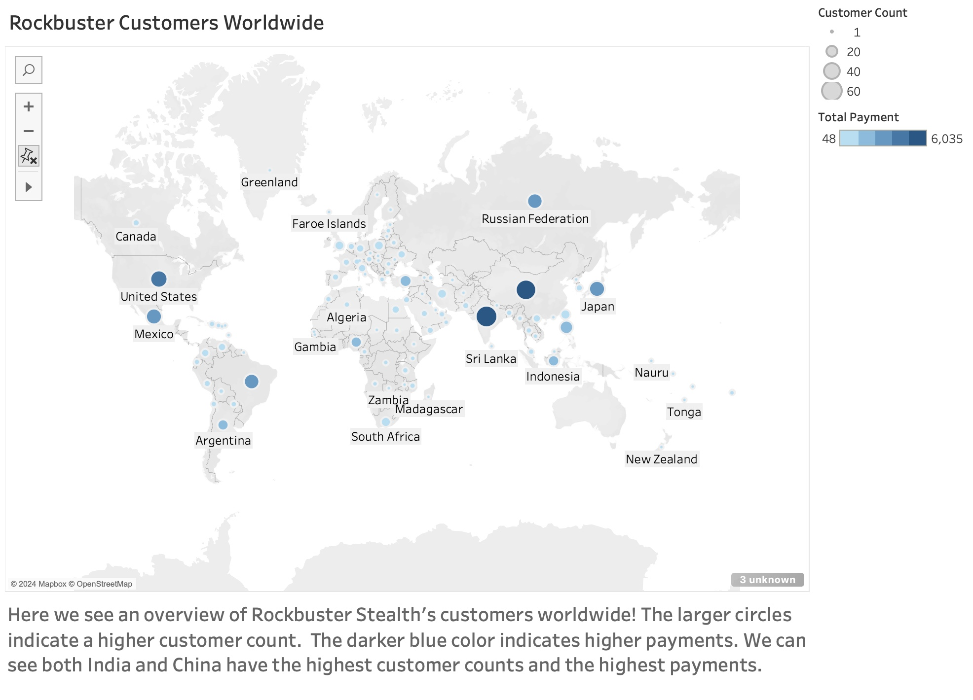

Link to Workbook
There are 1000 movies in the Rockbuster database!
Average rental duration for all videos is 5 days.

Slide 5
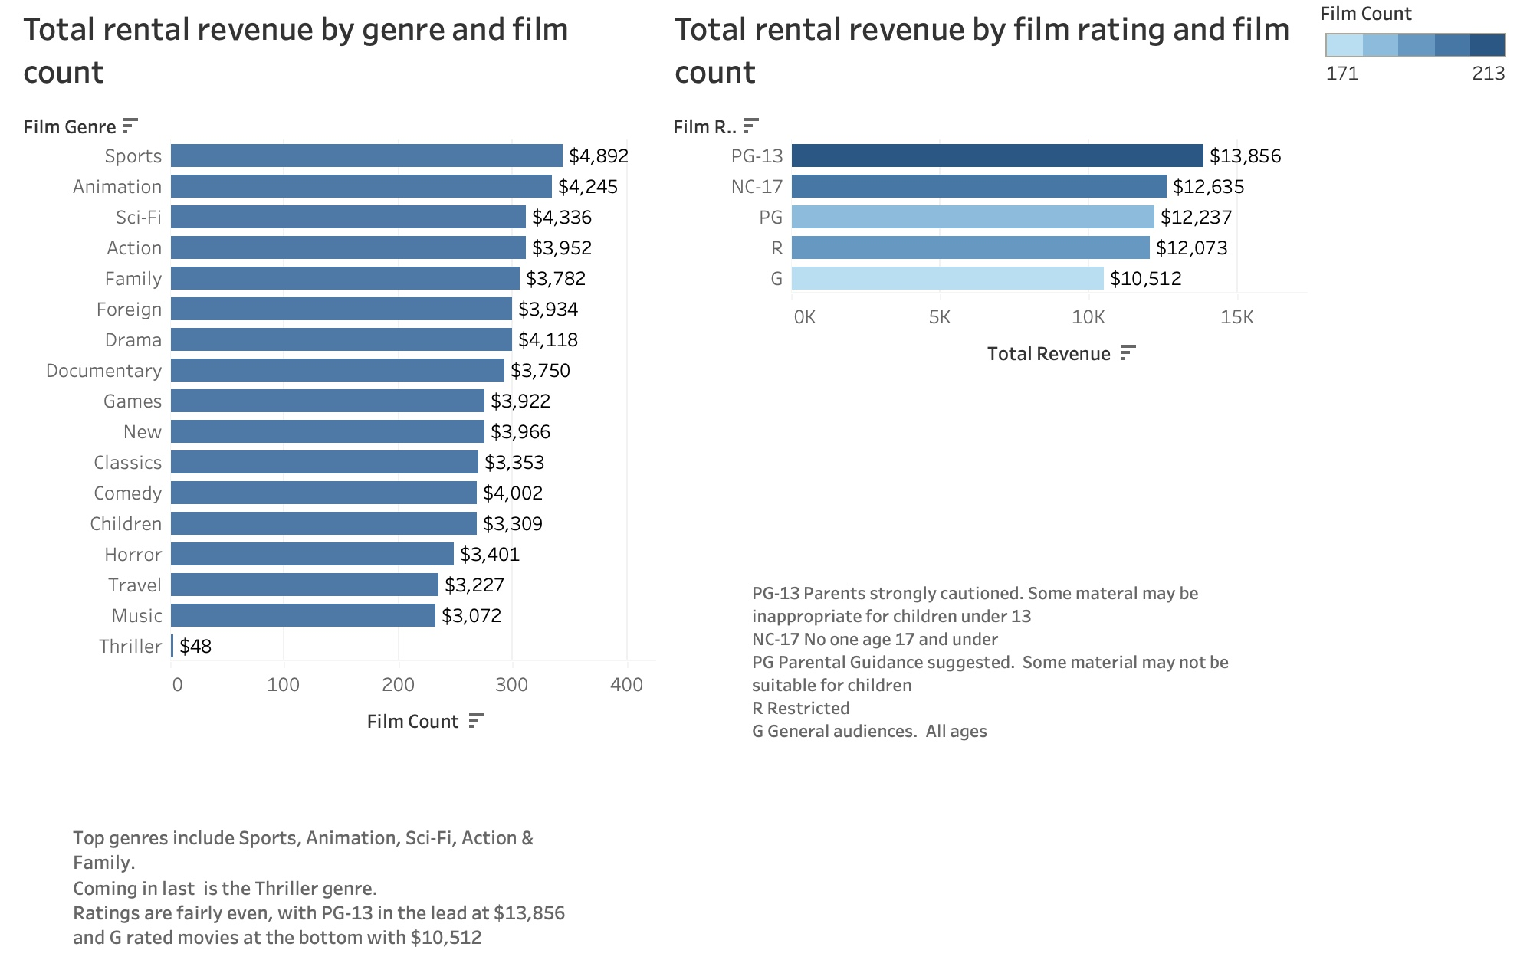

Slide 6
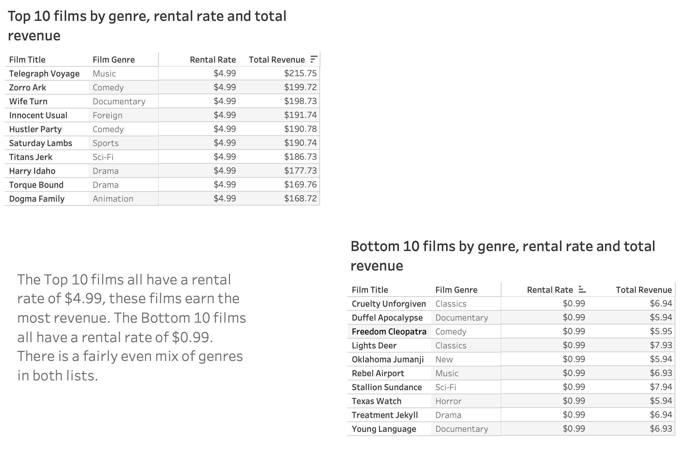

We see many genres in the Top 10 films – drama & comedy are most common in this table
Total overall revenue for Rockbuster is $61,312

Slide 7
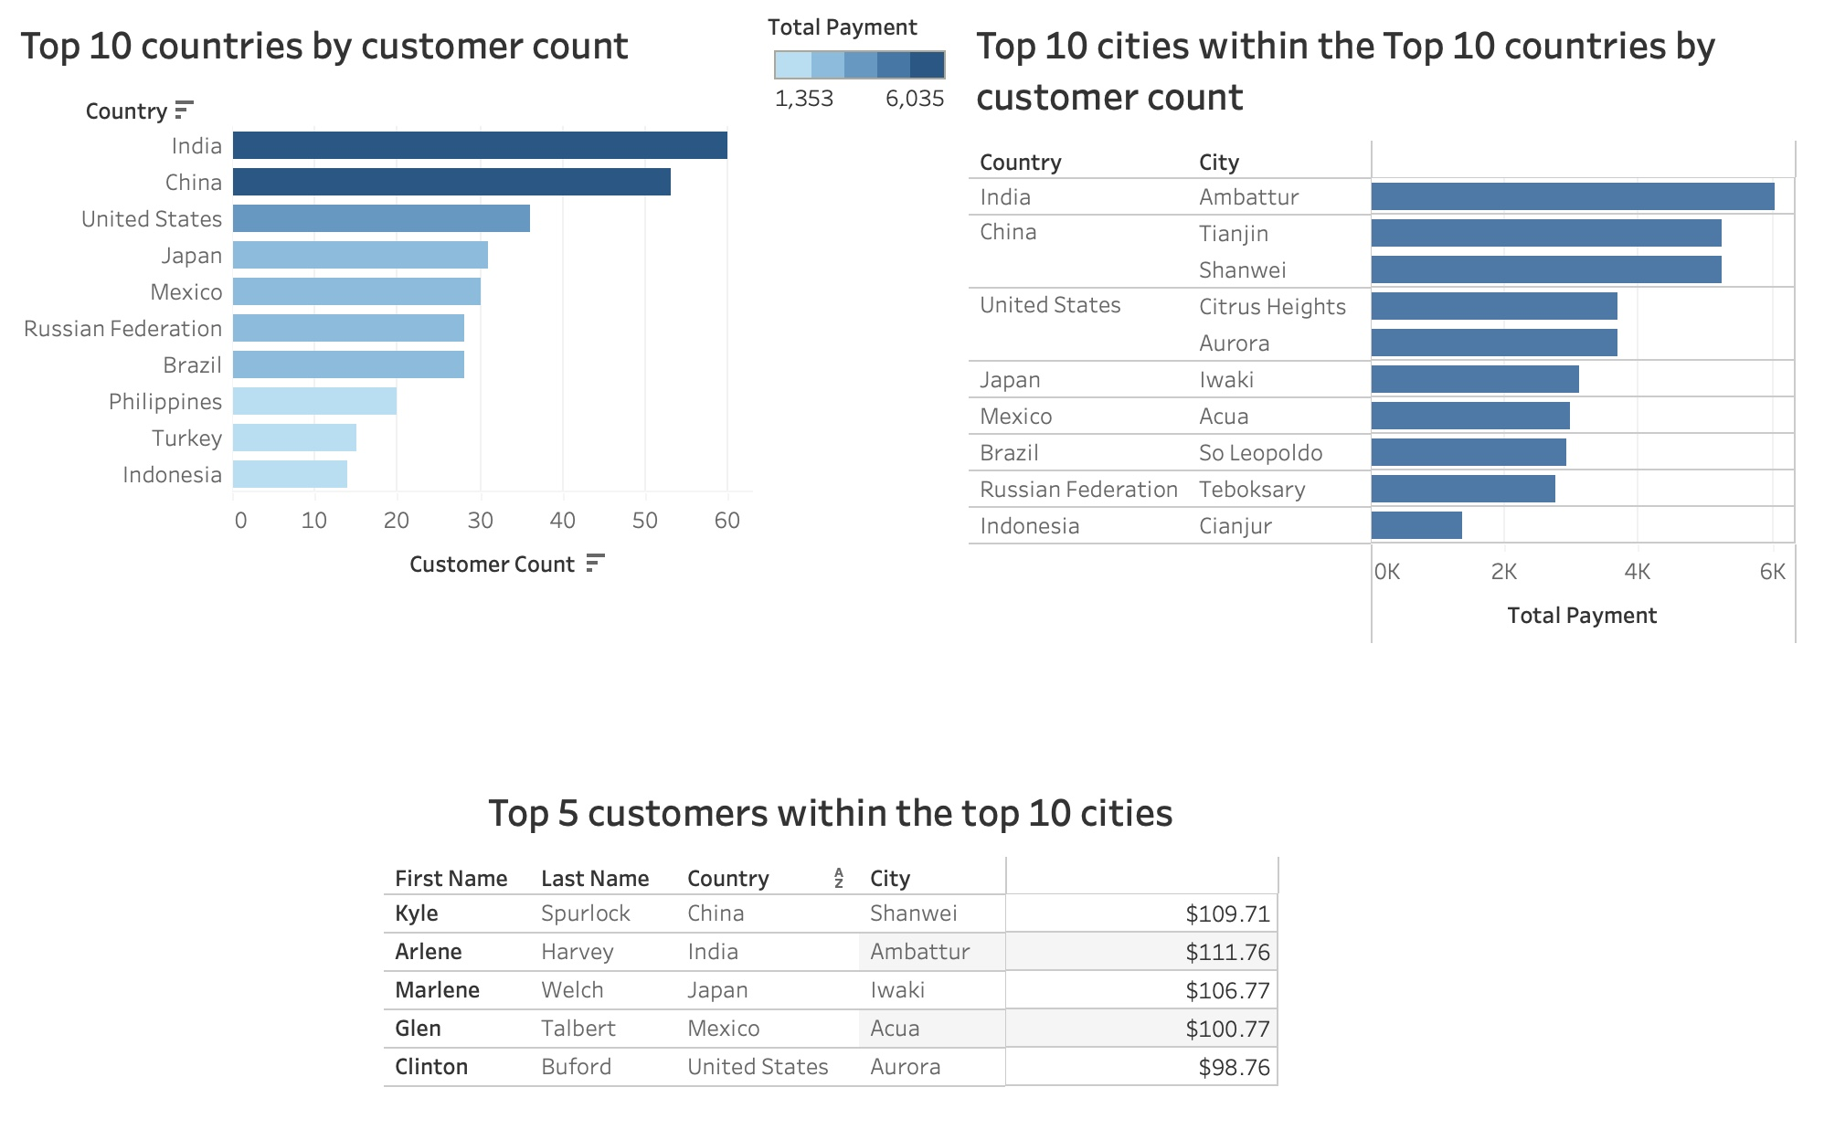

Total dollars spent

Slide 8
Recommendations
A paid membership program to increase consumer loyalty and increase revenue
Advertising on social media platforms
Expanding content of the comedy, drama, sports and animation genres can help generate extra revenue
Creating or acquiring content specifically for the countries of India & China as these have the highest customer count

Slide 9
Questions?

Slide 10

Thank you!

